Slide 1
The World in 2030:
Exploring the Sustainable Development Goals

Slide 2
The World in 2030
Exploring the Sustainable Development Goals
Objectives:
Learn about the Sustainable Development Goals
Encourage you to support the goals through your own work
Notes:
Before the lesson, conduct an activity to demonstrate inequality.
Divide students into equal groups. Each group is supposed to make a Birthday Card for a friend. Emphasize the scenario – it is your friends birthday, and you are really excited to be invited. You really want to make a nice card, and you know your friend will be happy to receive it. Can you do it? If you have time, show students an example of the birthday card they should make (perhaps with a cut out balloon glued to the front of the card).
At each table, place a paper bag with supplies. However, each bag will have different supplies. The students don’t know, but you have based the supplies based on the region of the world they are representing
1. (36% of the class) Representing High Income Countries: Include markers, coloured paper, scissors, glue
(26% of the class) Representing Upper Middle Income Countries: Plain paper, markers
(39% of the class) Representing Low/Low Middle Income Countries: Paper, a regular pencil
These statistics are based off the the World Bank classification found in January 2018 here: https://datahelpdesk.worldbank.org/knowledgebase/articles/906519
Without telling the students, say ‘Go’ and get them to make their card. Pretty soon some will realize they can’t make the card according to the directions
After 5-6 minutes of letting them figure out what to do (and some panic), stop them and ask.
What is the problem?
Do you have what you need?
How do you feel about that?
Discuss that some groups have MORE than they need to make a card (coloured paper, glue, scissors), some have just enough, and some don’t have enough. This is like the world we live in.
Ask students if they know any countries that would be low income, middle income, or high income.
Emphasize that we want to live in a world where people have what they need to live a happy, sustainable life. And that’s why the world agreed on the Sustainable Development Goals.

Slide 3
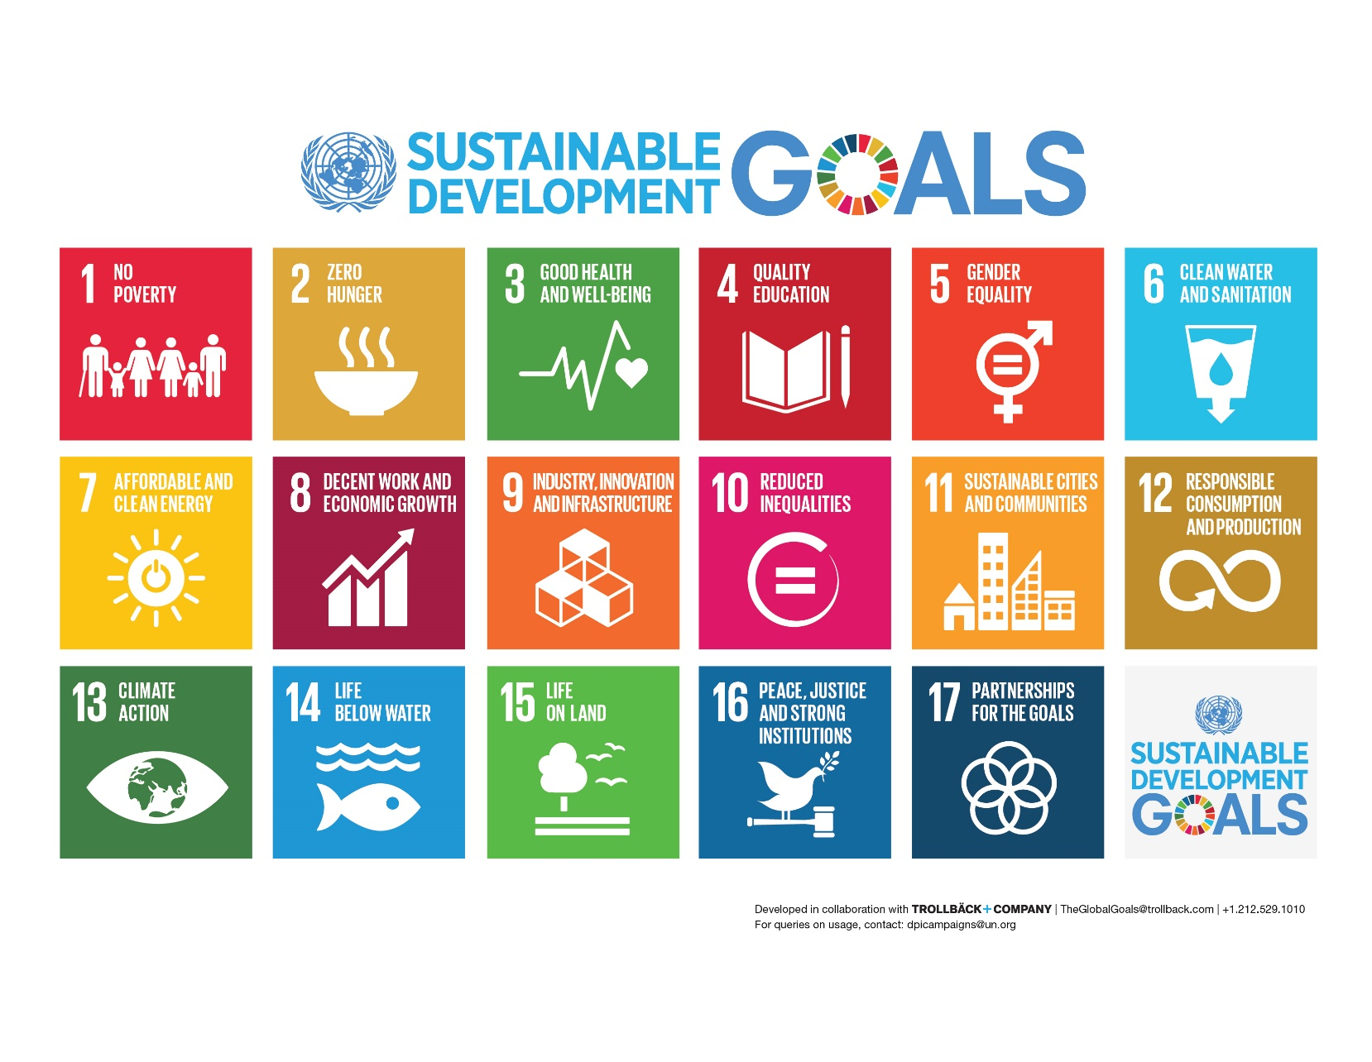
Watch: World’s Largest Lesson
https://www.youtube.com/watch?v=cBxN9E5f7pc
Notes:
Play the video about the goals, then discuss
What were some of the problems identified in the video? As students answer, point to some of the goals.
Do we have some of these problems in Canada?
Do you think we can work together to solve these issues by 2030?
Teacher Background: How were the goals created? Alongside the open working group discussions, the UN conducted a series of “global conversations”. These included 11 thematic and 83 national consultations, and door-to-door surveys. The UN also launched an online My World survey asking people to prioritise the areas they’d like to see addressed in the goals. The results of the consultations were fed into the the working group’s discussions.

Slide 4
What can I do?
ABOUT THE GOALS
YOUR IDEAS WITH OTHERS
TO MAKE CHANGE
Notes:
Even if you are young, there are many ways you can achieve the goals by 2030. First, you can learn about the Goals. That is what we are doing today! Next, you can share your ideas with others – you can tell others about the goals, or share with them ideas to make changes in your community. Finally, you can take action to make change! Even if you are young, there are many ways you can make change.

Slide 5
How YOU can take action!
Notes:
But how can you make change? There are 4 main ways to take action! You can use your Time, your Talent, your Treasure, or your voice( Tell!). Can anyone give an example of this?

Slide 6
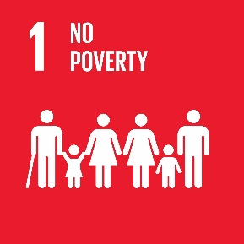
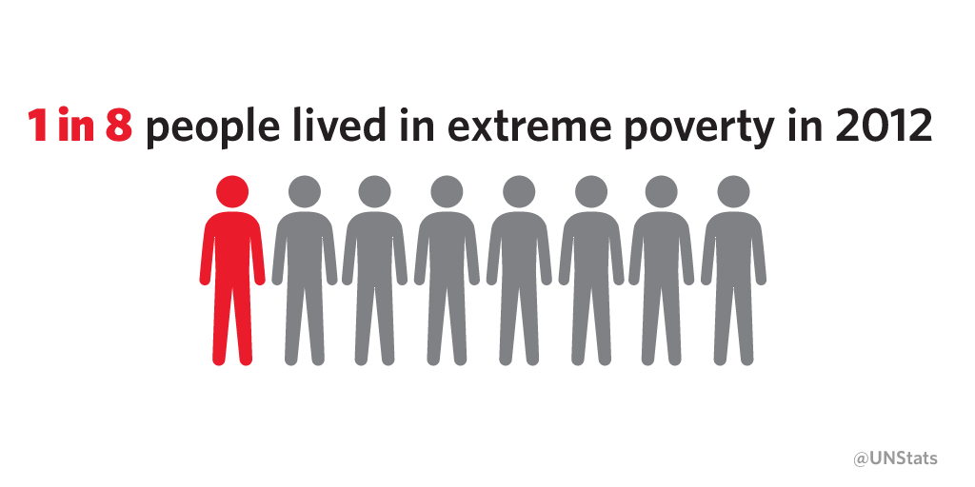
End poverty in all its forms everywhere
Less than $1.25/day
Source: @UNStats
Found in: The Sustainable Development Goals Report 2016 , https://unstats.un.org/sdgs/report/2016/Overview/
Notes:
So lets take a look at some of the goals, and learn about a few regular people who are working on these goals. Here is Goal 1: No Poverty. In the world, 1 in 8 people live in extreme poverty, which means earning less than $1.25/day.
Found in: The Sustainable Development Goals Report 2016 , https://unstats.un.org/sdgs/report/2016/Overview/
Date Found: 5 February 2018

Slide 7
End poverty in all its forms everywhere
We
the People
In Canada, a single person, living in poverty means they make less than $22,133, or $60/day
Source: Canada Without Poverty, http://www.cwp-csp.ca/poverty
Found at: Where Canada Stands: A Sustainable Development Goals Progress Report, BC COUNCIL FOR INTERNATIONAL COOPERATION, 2017: https://bccic.ca/wp-content/uploads/2017/07/HLPF-Report-Online-Version-v1-07072017.pdf
Notes:
Do we have poverty in Canada? Yes. In fact, 4.9 million people live in poverty in Canada. In Canada, things cost more money, but we also earn more money. Therefore, an individual that makes less than $60/day is Canada considered living in poverty.

Slide 8
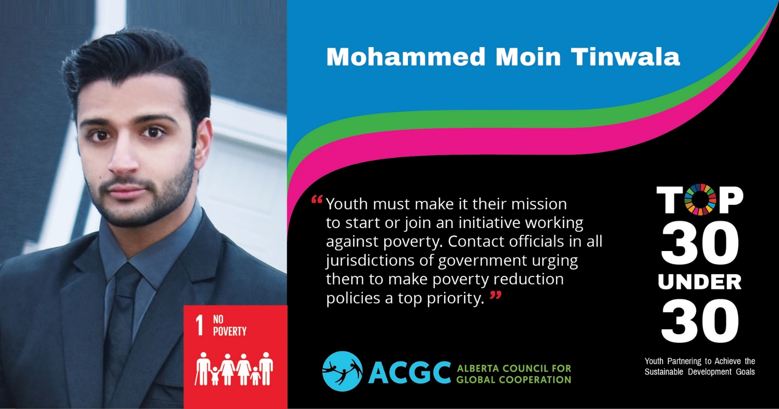
End poverty in all its forms everywhere
We
the People
Mohammed started his own organization, raising money to build an orphanage in Pakistan.
Notes:
This is Mohammed from Calgary. He is passionate about Goal 1. He started his own organization, raising money to build an orphanage in Pakistan. Did he use his time, talent, treasure, or voice to make change?
Find Mohammed’s profile in the 2018 Top 30 Under 30 magazine here: http://acgc.ca/get-involved/top-30-under-30-magazine/

Slide 9
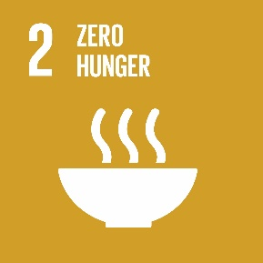
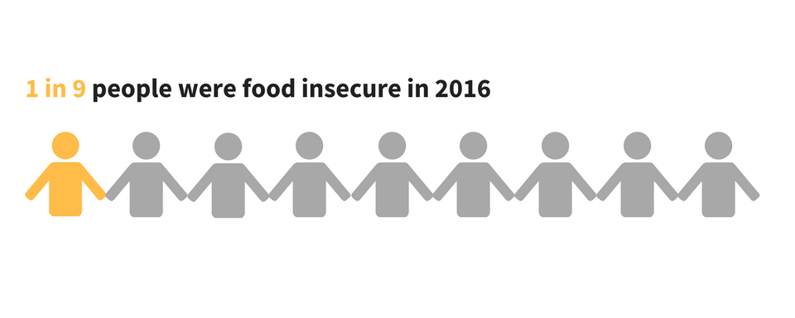
End hunger, achieve food security and improved nutrition, and promote sustainable agriculture
We
the People
Source: The State of Food Insecurity in the World: 2015, FAO
Found at: http://www.fao.org/3/a-i4646e.pdf
Notes:
Read Goal 2. In the world, 1 in 9 people were food insecure. Explain food insecurity.
Found at: http://www.fao.org/3/a-i4646e.pdf

Slide 10
End hunger, achieve food security and improved nutrition, and promote sustainable agriculture
We
the People
Source: PROOF
Found at: Where Canada Stands: A Sustainable Development Goals Progress Report, BC COUNCIL FOR INTERNATIONAL COOPERATION, 2017: https://bccic.ca/wp-content/uploads/2017/07/HLPF-Report-Online-Version-v1-07072017.pdf
Notes:
In Canada, we also have food insecurity. What do you notice about this map?
Found at: Where Canada Stands: A Sustainable Development Goals Progress Report, BC COUNCIL FOR INTERNATIONAL COOPERATION, 2017: https://bccic.ca/wp-content/uploads/2017/07/HLPF-Report-Online-Version-v1-07072017.pdf
Date found: 5 February 2018

Slide 11
End hunger, achieve food security and improved nutrition, and promote sustainable agriculture
We
the People
Juanita knows how to cook great food. She provides cooking classes to newcomers and youth so they can feel more confident in cooking their own meals.
Notes:
Juanita is from Edmonton. She is passionate about Goal 2. Juanita knows how to cook great food. She provides cooking classes to newcomers and youth so they can feel more confident in cooking their own meals. Did she use his time, talent, treasure, or voice to make change?
Find Juanita’s profile in the 2018 Top 30 Under 30 magazine here: http://acgc.ca/get-involved/top-30-under-30-magazine/

Slide 12
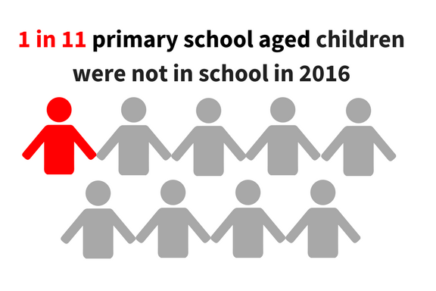
Ensure inclusive and equitable quality education and promote lifelong learning opportunities for all
We
the People
Source: UNESCO. Leaving No One Behind. How far on the way to Universal Primary and Secondary Education, 2016
Found at: http://uis.unesco.org/sites/default/files/documents/fs37-leaving-no-one-behind-how-far-on-the-way-to-universal-primary-and-secondary-education-2016-en.pdf
Notes:
Found at: http://uis.unesco.org/sites/default/files/documents/fs37-leaving-no-one-behind-how-far-on-the-way-to-universal-primary-and-secondary-education-2016-en.pdf
Date found: Feb 5, 2018
As a comparison
72 million more children were in primary school in 2015 in GPE partner countries compared to 2002. https://www.globalpartnership.org/data-and-results/education-data
See charts at https://data.unicef.org/topic/education/primary-education/

Slide 13
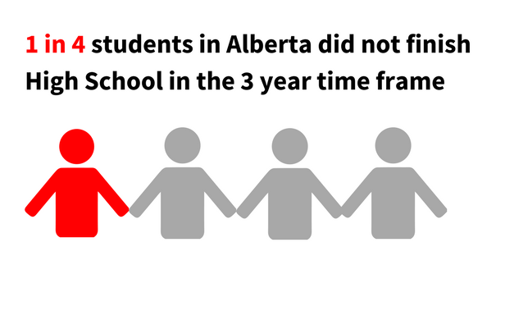
Ensure inclusive and equitable quality education and promote lifelong learning opportunities for all
We
the People
Source: Alberta Education, Accountability Pillar Results for Annual Education Results Report (AERR) Oct 2016
Found at: https://education.alberta.ca/media/3273036/apori_201610_province_province-report.pdf
Notes:
Found at: https://education.alberta.ca/media/3273036/apori_201610_province_province-report.pdf
Date: February 5, 2018

Slide 14
Ensure inclusive and equitable quality education and promote lifelong learning opportunities for all
We
the People
McNiel is originally from South Sudan. He spends his time mentoring other newcomer youth.
Notes:
McNiel is from Edmonton. He came from South Sudan when he was young. He is passionate about Goal 4, and spends his time mentoring newcomer youth.
Did he use his time, talent, treasure, or voice to make change?
Find McNeil’s profile in the 2018 Top 30 Under 30 magazine here: http://acgc.ca/get-involved/top-30-under-30-magazine/

Slide 15
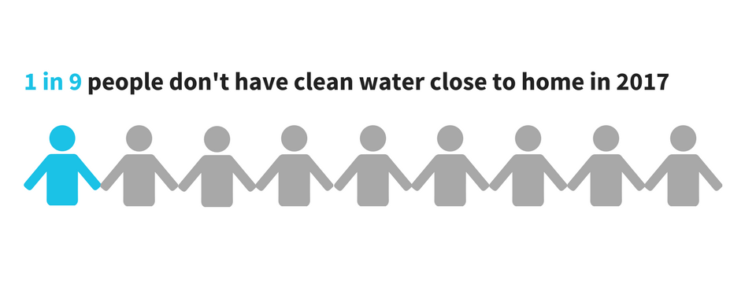
Ensure availability and sustainable management of water and sanitation for all.
Source: WASHWatch
Found at: WaterAid: https://www.wateraid.org/facts-and-statistics
Notes:
www.wateraid.org/facts-and-statistics

Slide 16
Ensure availability and sustainable management of water and sanitation for all.
72
First Nations Communities in Canada can’t drink their water
Source: Government of Canada
Found at: http://www.aadnc-aandc.gc.ca/eng/1506514143353/1506514230742 Updated May 2018
Notes:
Valid as of 4 May 2018. Found at http://www.aadnc-aandc.gc.ca/eng/1506514143353/1506514230742

Slide 17
Ensure availability and sustainable management of water and sanitation for all.
Tikho is from Zambia. She is an advocate for clean water and proper sanitation, and tells people in her community about the issues
Notes:
Tikho is from Zambia and is passionate about Goal 6. She is a youth advocate for clearn water and proper sanitation, and tells people in her community about the issue, with the support of the Calgary organization, the Center for Affordable Water and Sanitation Technology (CAWST). Did she use her time, talent, treasure, or voice to make change?
Find Tikho’s profile in the 2018 Top 30 Under 30 magazine here: http://acgc.ca/get-involved/top-30-under-30-magazine/
Find other lessons involving Tikho here: https://www.cawst.org/wavemakers/educators/teach/tikhostory

Slide 18
Brainstorm!
Notes:
We have now learned about other young people who are using their time, talent, treasure, and voice to make change. Ask the class for their input: What are ways you can use your time, talent, treasure, or voice to make change?
As an extension: distribute this graphic to groups, and they can brainstorm ideas they can do in their school, or ways they can help.

Slide 19
“Be a global citizen. Act with passion and compassion. Help us make this world safer and more sustainable today and for the generations that will follow us. That is our moral responsibility.”
-Ban Ki Moon, former UN Secretary General
Be a Hummingbird
https://www.youtube.com/watch?v=IGMW6YWjMxw
Notes:
Even if you are young, you can make a great change.
Watch ‘Be a Hummingbird’.

Slide 20
www.acgc.ca
@ACGCNow

