Slide 1
LEARN ABOUT 17 GOALS in 17 WEEKS

Slide 2
The Alberta Council for Global Cooperation is a coalition of organizations located in Alberta, working locally and globally to achieve sustainable human development. ACGC supports organizations and individuals to work towards ending poverty and achieving a healthy world.
LEARN MORE AT WWW.ACGC.CA

Slide 3
2018 MEMBERS
LEARN MORE AT WWW.ACGC.CA

Slide 7
LEARN ABOUT 17 GOALS in 17 WEEKS
Notes:
This series of writing/discussion prompts on the SDGs can be altered for your class. Videos included are of projects by Alberta-based international development organizations working on those particular SDGs around the world.

Slide 8
End poverty in all its forms everywhere

Slide 9
Prompt:
Why is it difficult to end poverty? Do you think poverty is growing or reducing?

Slide 10
Numbers in Action

Slide 11
End hunger, achieve food security and improved nutrition and promote sustainable agriculture

Slide 12
Prompt:
Describe the journey your food took to get to you today

Slide 13
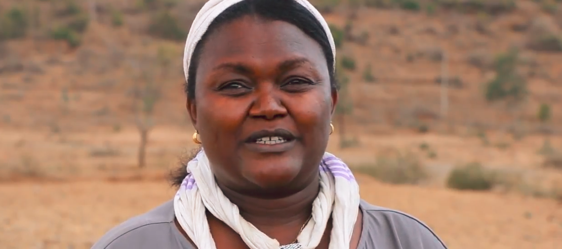
Rainbow for the Future
Westlock, Alberta

Slide 14
Ensure healthy lives and promote well-being for all at all ages

Slide 15
Prompt:
Canada is well known for supporting maternal and child health initiatives around the world. Why is this important to global development?

Slide 16
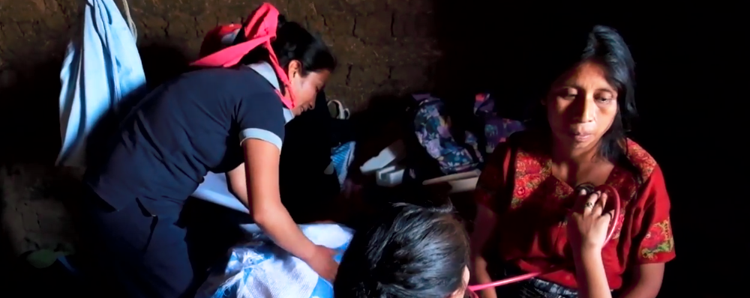
CAUSE Canada
Calgary, Alberta

Slide 17
Ensure inclusive and equitable quality education and promote lifelong learning opportunities for all

Slide 18
Prompt:
You have two children: one girl and one boy. You can only afford to send one to school. What would you do?

Slide 19
Canadian Humanitarian
Medicine Hat, Alberta

Slide 20
Achieve gender equality and empower all women and girls

Slide 21
Prompt:
What tasks, activities, or choices are you expected to do/make because of your gender? How does it make you feel?

Slide 22
Canadian Women for Women in Afghanistan
Calgary, Alberta

Slide 23
Ensure availability and sustainable management of water and sanitation for all

Slide 24
Prompt:
Where does your poo go after you flush?

Slide 25
Centre for Affordable Water and Sanitation (CAWST)
Calgary, Alberta

Slide 26
Ensure access to affordable, reliable, sustainable and modern energy for all

Slide 27
Prompt:
How would your day be different without electricity?

Slide 28
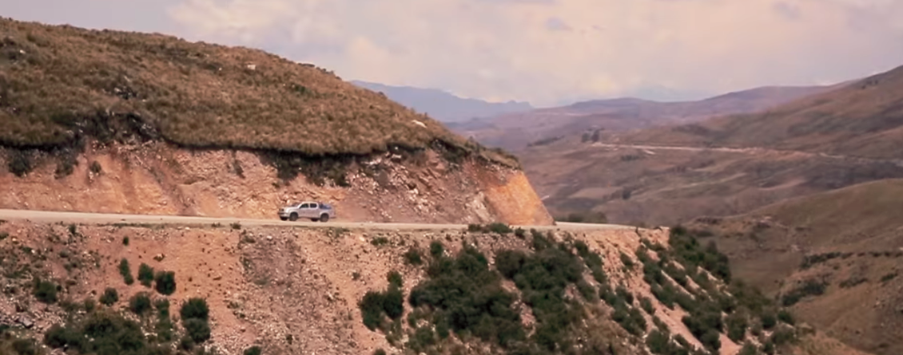
Light Up the World
Calgary, Alberta

Slide 29
Promote sustained, inclusive and sustainable economic growth, full and productive employment and decent work for all

Slide 30
Prompt:
What is your vision of work? What is ‘decent’ work?

Slide 31
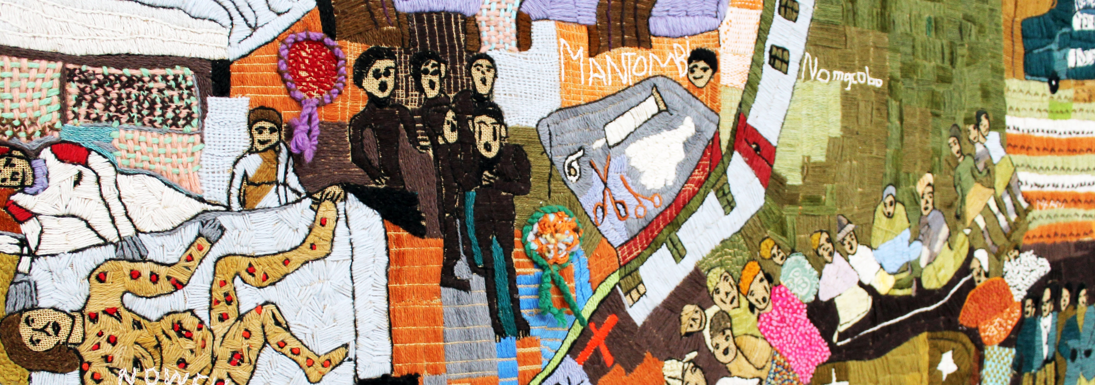
Keiskamma Canada Foundation
Edmonton, Alberta

Slide 32
Build resilient infrastructure, promote inclusive and sustainable industrialization and foster innovation

Slide 33
Prompt:
How do roads and bridges contribute to poverty reduction?

Slide 34
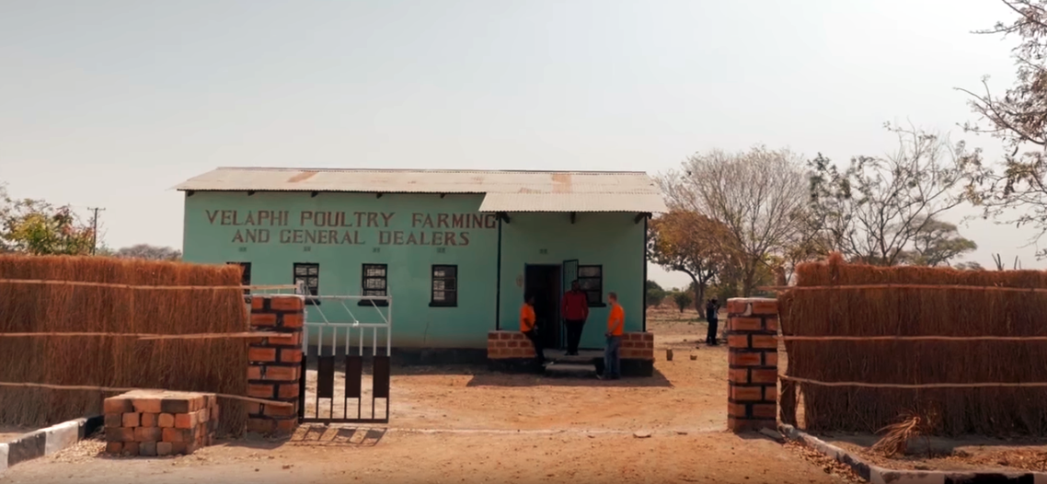
Engineers Without Borders
Local Chapters Across Alberta

Slide 35
Reduce inequality within and among countries

Slide 36
Prompt:
Describe a time when you or someone you know has been discriminated against. How can this situation be prevented?

Slide 37
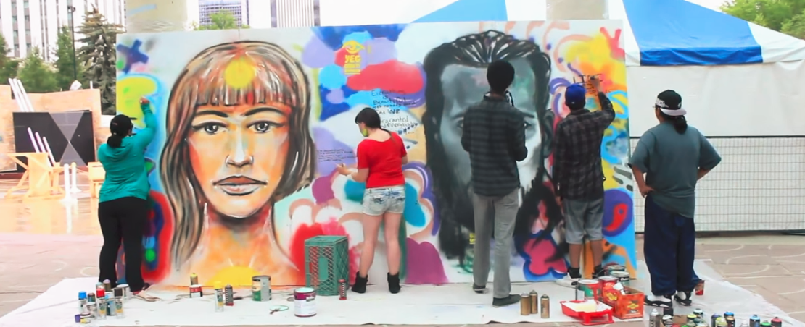
John Humphrey Centre for Peace and Human Rights
Edmonton, Alberta

Slide 38
Make cities and human settlements inclusive, safe, resilient and sustainable

Slide 39
Prompt:
What is resiliency?
How can you (and your community) become more resilient?

Slide 40
Samaritan’s Purse
Calgary, Alberta

Slide 41
Ensure sustainable consumption and production patterns

Slide 42
Prompt:
Are you a responsible consumer? Why/Why not?

Slide 43
Mennonite Central Committee Alberta
Calgary, Alberta

Slide 44
Take urgent action to combat climate change and its impacts

Slide 45
Prompt:
What are some ways your community should adapt to climate change?

Slide 46
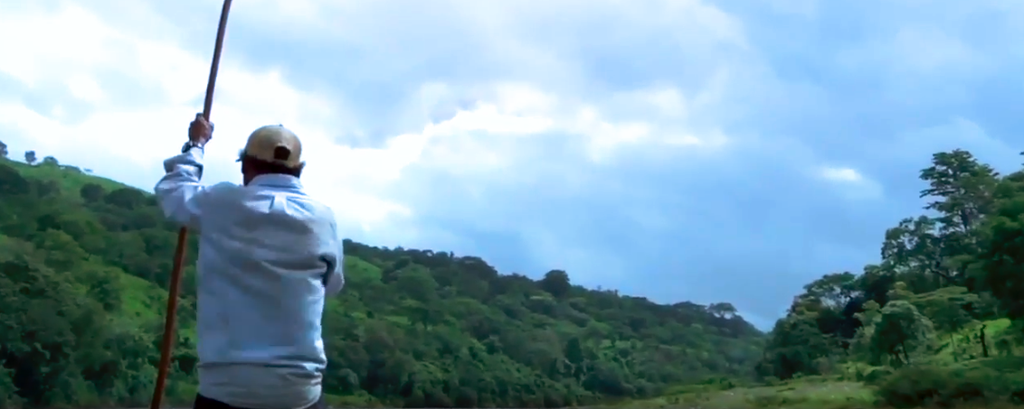
Change for Children Association
Edmonton, Alberta

Slide 47
Conserve and sustainably use the oceans, seas and marine resources for sustainable development

Slide 48
Prompt:
In your opinion, what is the biggest threat facing the oceans today?

Slide 49
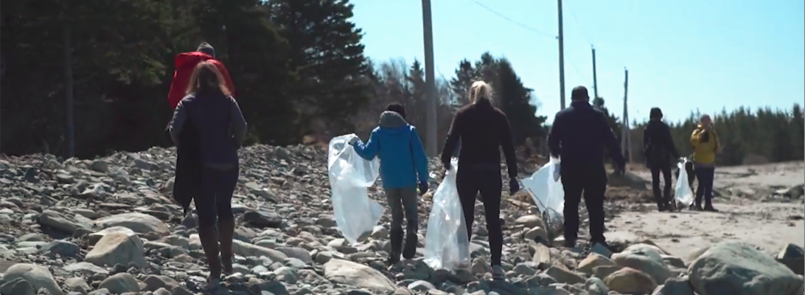
Protecting the world’s oceans from plastics pollution – Environment and Climate Change Canada

Slide 50
Protect, restore and promote sustainable use of terrestrial ecosystems, sustainably manage forests, combat desertification, and halt and reverse land degradation and halt biodiversity loss

Slide 51
Prompt:
Imagine a world without trees. How would life be different?

Slide 52
Oxfam Canada

Slide 53
Promote peaceful and inclusive societies for sustainable development, provide access to justice for all and build effective, accountable and inclusive institutions at all levels

Slide 54
Prompt:
What is peace?

Slide 55
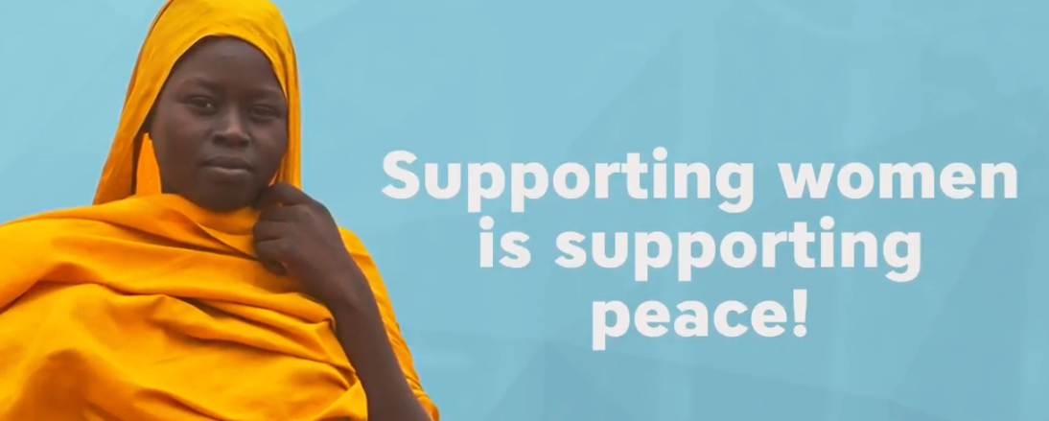
Development and Peace, Caritas Canada
Edmonton, Alberta (Western Regional Office)

Slide 56
Strengthen the means of implementation and revitalize the global partnership for sustainable development

Slide 57
Prompt:
What should be Canada’s role in funding sustainable human development around the world?

Slide 58
Canadian Council for International Cooperation
Ottawa, Ontario

