Slide 1
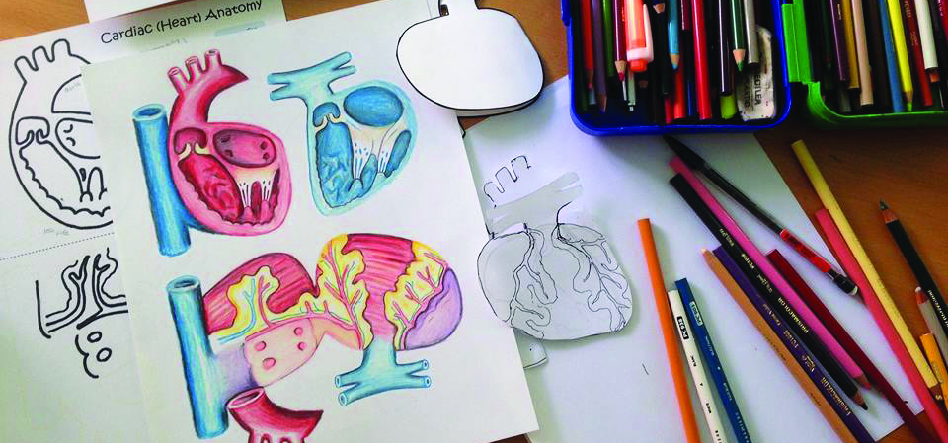
Design for Health: CTF Challenge
^{www.together.acgc.ca}

Slide 2
About ACGC
The Alberta Council for Global Cooperation is a coalition of organizations located in Alberta, working locally and globally to achieve sustainable human development. ACGC supports organizations and individuals to work towards ending poverty and achieving a health world.

Slide 3
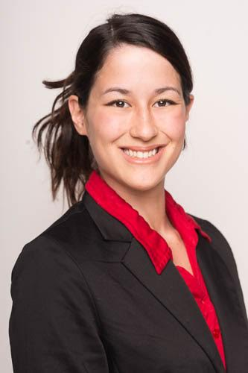
About Dr. Michiko Maruyama
Dr. Michiko Maruyama graduated from the University of British Columbia Northern Medical Program in 2015 and she was accepted into the Cardiac Surgery Residency Program at the University of Alberta.
Prior to starting medical school, Michiko completed an Industrial Design degree (Engineering Route) at the University of Alberta. While completing a cardiac surgery residency in Edmonton, she is concurrently working towards a Master of Industrial Design degree. Michiko continues to actively explore and integrate medicine, art and design.
See Dr. Maruyama’s work at
www.artoflearning.ca

Slide 4
About the:
The UN Sustainable Development Goals are a set of 17 global goals agreed upon by 196 nations on September 25th, 2015, to combat extreme poverty, reduce inequality, and tackle climate change by 2030.
This lesson supports Goal 3:
Ensure healthy lives and promote wellbeing for all at all ages
www.globalgoals.org

Slide 5
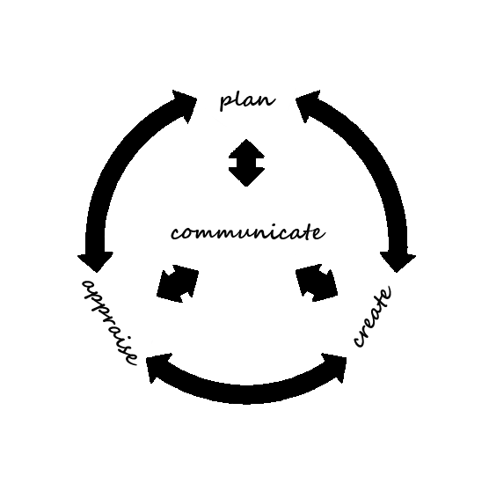
Design for Health: CTF Challenge
In this challenge, students will design a product to help a non-profit organization communicate key health messages to children living in a rural, low-income setting in a developing country.
Taking inspiration from Dr. Michiko Maruyama, students will explore the occupational clusters of Communications and Human Services while completing this CTF Challenge.

Slide 6
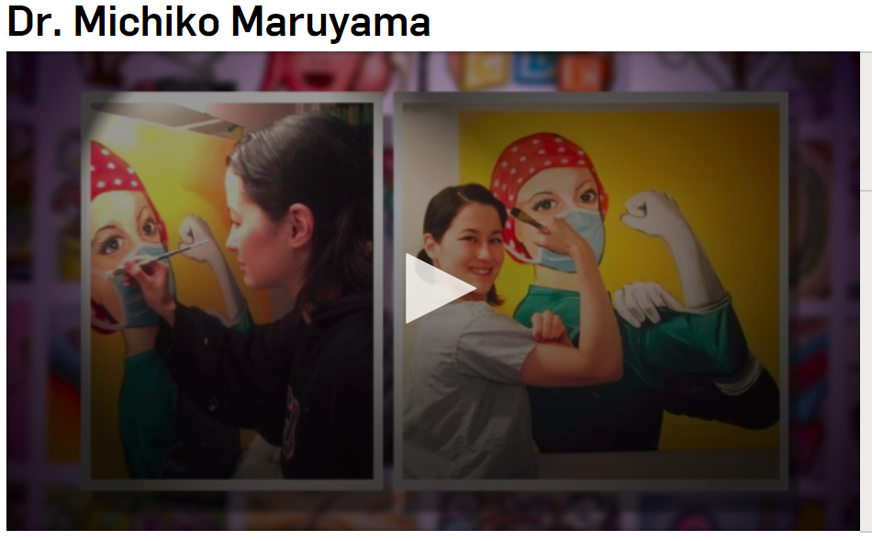
Alberta Story:
CTV Alberta Primetime: Wednesday, May 16th, 2018
https://alberta.ctvnews.ca/dr-michiko-maruyama-1.3933016

Slide 7
Discuss
• Why did Dr. Maruyama become interested in medicine?
^{• How} does Dr. Maruyama combine her interests in medicine and design?
• What things has Dr. Maryuama designed in order to help her patients?
• Why is Dr. Maryuama’s unique approach innovative? How does it benefit patients, especially children?
• From what you have read/heard, what is cardiac surgery? What is industrial design? Brainstorm ways industrial design impacts medicine.
• How is Dr. Maruyama working towards the UN Sustainable ^{Development Goals?}
https://www.youtube.com/watch?v=cEGIbgC9BE8&t=267s

Slide 8
The Challenge
How can you design a simple product, tool, or health promotion campaign to effectively communicate a health message to children living in a rural, low income setting?
Photo Credit: ACGC. 2015

Slide 9
Challenge Description
Students plan and design a product, tool or health promotion campaign for a non-profit organization working to address health issues in a developing country. Students may work with the organization to understand key health issues and the local context, including cultural understandings. Students research common health issues in the location, as well as treatments and prevention methods.
In groups, students develop a simple tool or product that would help a health care worker visually explain the health issue to children. This tool is tested with children for its effectiveness in communicating the health issue.

Slide 10
Scenario
An Alberta non-governmental organization (NGO) is supporting a health program in a small hospital clinic in a developing country [students may pick!].
The area where the clinic is located does not have access to the internet, and has limited electricity. The need for basic health information is huge, but access to information is difficult.
Your job is to develop a product, tool, or health promotion campaign to effectively communicate important health messages to children, while respecting local cultural understandings.

Slide 11
Complete the Challenge
Define your issue
Understand the problem
Generate Ideas
Evaluate and choose your best idea
Develop the idea
Test the idea
Implement the idea

Slide 12
Read more stories at www.together.acgc.ca
Learn more about ACGC
www.acgc.ca
Learn more about
Dr. Michiko Maruyama
www.artoflearning.ca

